Slide 1
Sign Language Interpretation
D
Tan Kah Heng Darryl
E

Slide 2
TABLE OF CONTENTS
01.
02.
03.
04.
Project Background
Data Collection
Model and Optimisation
Results

Slide 3
Project Background
Sign Language requires lots of lessons and workshops to understand, especially when face to face and there is no available translator. Therefore, use Arduino Nano Sense Board with Deep Learning to interpret sign language for those with no knowledge of sign language.
R
G
T

Slide 4


Singapore Sign Language References

Slide 5
Problems Faced
Sign Language often uses fingers to denote letters as well, which the IMU could not capture.
Multiple words correspond to the same type of gesture (e.g. Good and Thank you)
Simple Deep NN could not detect subtle gesture differences using IMU (Accelerometer and gyroscopes can only record changes in movement)

Slide 6
Data Collection
“how” → 75 gesture data
“me” → 75 gesture data
“bus” → 75 gesture data
“you” → 75 gesture data

Slide 7
Model
Dense Layer → 64 Neurons
Dense Layer → 64 Neurons
Dense Layer → 32 Neurons
Dense Layer → 32 Neurons

Slide 8
Optimisation
Early Stopping to stop training if validation loss increases instead of decreasing.
Quantization of all weights, biases and activation
Reduced size from 215756 bytes to 57728 bytes (reduction of 73.24%).

Slide 9
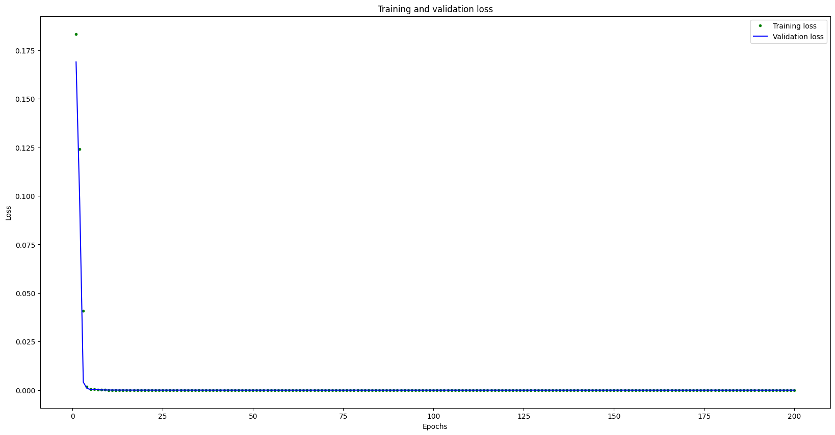
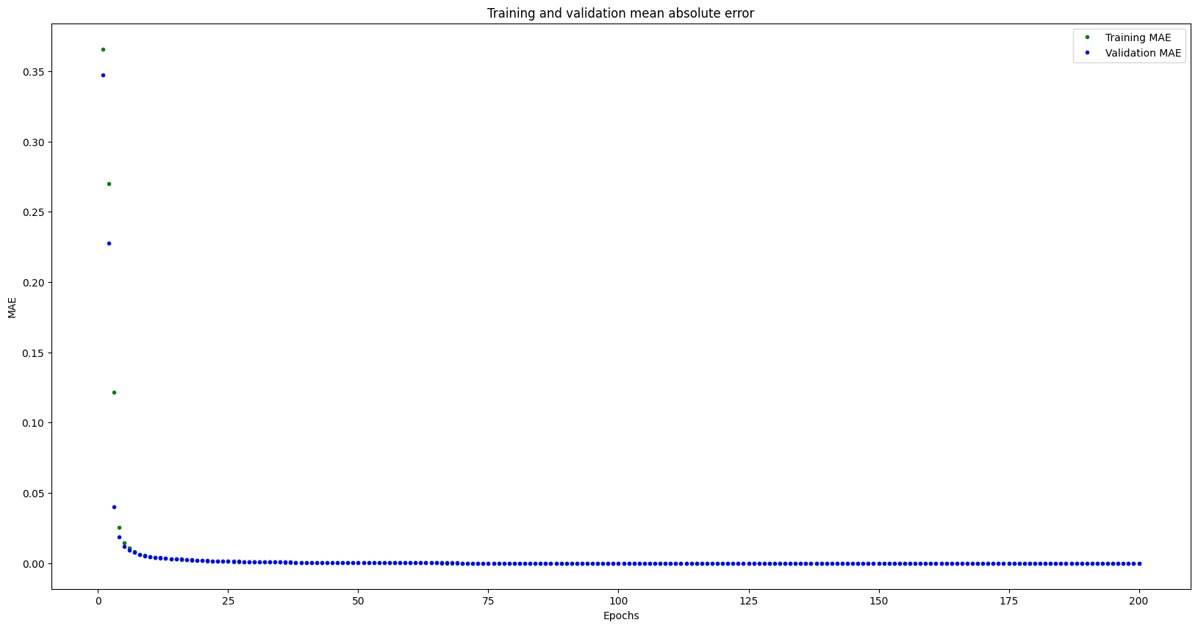
Results
Accuracy: 100%

Slide 10
Demo
C
B

Slide 11
Areas of improvements
Instead of using a normal deep learning, can explore using convolutional neural networks instead to recognise complex gestures.
Attach another IMU or Nano 33 BLE Sense Board on the other hand as sign language requires 2 hand gestures.
Find a way to record finger movements as well as most gestures requires finger movement.
Find a way to distinct 2 similar gestures.

